Slide 2
Increased Production │ Reduced Well Cost │ Target Depth Assurance │ Wellbore Integrity
Elastic Phase Self-Lining Tubulars Resolve Limitations of Inflatable, Swellable, and Expandable Technologies
DTS Self-Lining / Self-Expansion Process is Unrelated to Yielded Expansion
Two DTS Technology Forms:
Interleaving, laminated tubular-spring provides pressure compliance
Porous helical lattice arrangements as high permeability sandscreens
Expansion Ratios >3X, Self-Sealing Pressure >10ksi
Expanded Form is the Natural Condition, Setting Forces are Tunable
Deployable by CT or Wireline
>50 Applications Covering D&C, Interventions, P&A
Current emphasis on thru-tubing applications

Slide 3
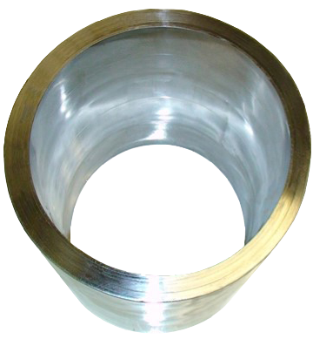
Increased Production │ Reduced Well Cost │ Target Depth Assurance │ Wellbore Integrity
Technology Features
Mechanical Performance Correlates with High Strength Material Construction
Yield strengths typically >200ksi
Hardness normally >50Rc, abrasion resistance is inherent
Low D:t <10, high strength steel / high expansion ratios capable
Burst and Collapse Properties are Approximately Equal
Certain Assemblies are Retrievable or Positionally Adjustable
DTS Thru-Tubing Solutions are Large Bore & Monodiameter Capable
Repaired ID allows subsequent repairs below
High Permeability Relining Screens for Compromised Sandcontrol
• Thru-tubing Capable
• Industry Best Sand Control Integral
• High Rate Capable
• Erosion Resistant
• Plug Resistant, Thorough Jetting Capable
High Strength Liners &
Claddings, Expansion >3X

Slide 4
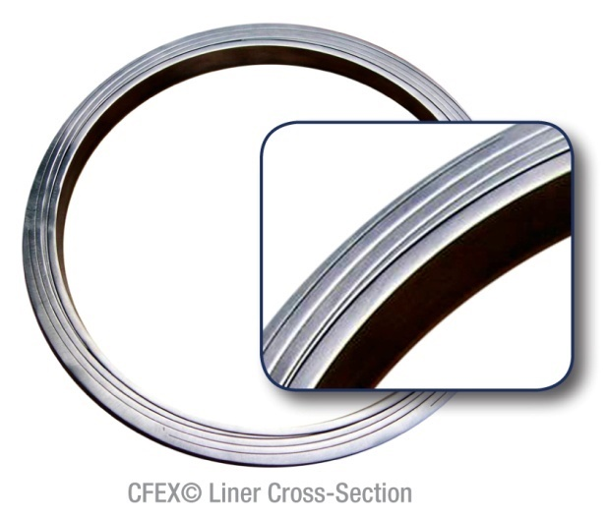
Increased Production │ Reduced Well Cost │ Target Depth Assurance │ Wellbore Integrity
‘Solids’ ─ Elastic Expansion Technology Principles
Process Is Fundamentally Opposite Yielded Expansion
Form Oversized Split Tubes from High
Strength Plate.
Assemble & Join Members as a
Diametrically Oversized Spring-Tubular:
– Laminated assembly
Temporarily Reduce Diameter & Secure
RIH, Release Elastically Biased Assembly
to its Operating Diameter.
Seal Wellbore By Residual Outward Spring Energy
– Self-hanging and self-sealing

Slide 5
3” OD Solid Liner Passed Through 4.5” Tubing, Set Capable >8.5”
http://dynamictubulars.com/high_speed_lab_film.htm

Slide 6
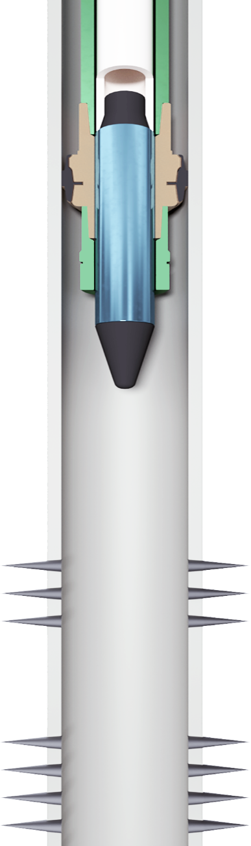
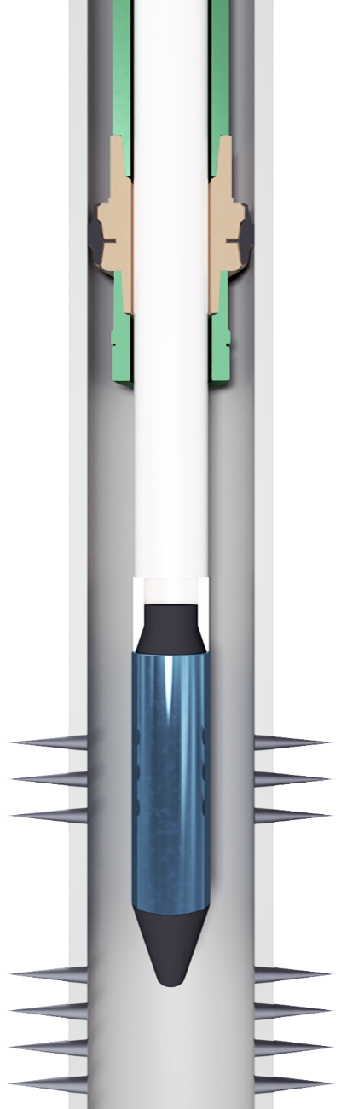
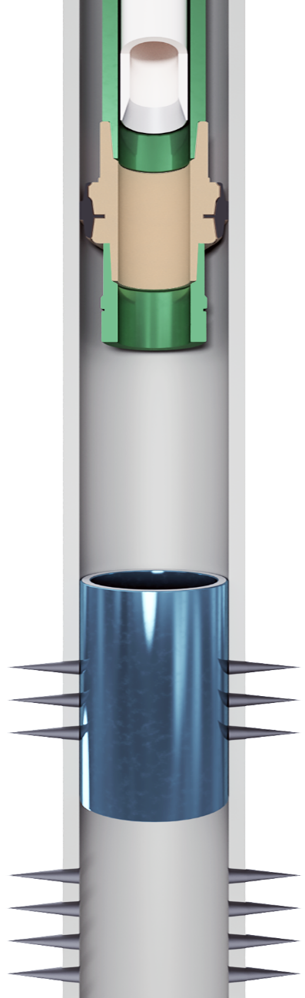
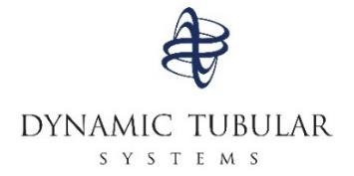
LARGE BORE THRU-TUBING ISOLATION, PATCH OR SAND RELINING RUNNING PROCEDURE
CT or Wireline
Production Tubing
Pre-Expansion Clad, Patch or Sand Relining
Maximum Post-Intervention
OD & ID:
Relining Lowered To Target Zone, Pressure or Electro-Mechanical Force Initiates Expansion
Self-Biasing Against Casing or Screen
Maximized Post-Set ID Enables Access For Subsequent Linings

Slide 7
Increased Production │ Reduced Well Cost │ Target Depth Assurance │ Wellbore Integrity
Uses of Full Access Thru-tubing, FATTCladding©
Water or gas shutoff against casing
More timely & reliable alternative to cement or chemical treatments
Isolation, pre-stimulation and/or post-stimulation
Thin-walled / high-strength tubing patches
Uses Under Consideration
Diversion of hotspots by scab liner set against screen
Partial water shutoff as scab liner set against screen
Sand shutoff as scab liner set against screen
Bridging / straddle conduit between short height chemical, solder or
cement treatments.
Radial / internal support of chemical, solder or cement treatments
behind pipe.

Slide 9
Thin Walled Tubing Patch Dimensions, >200ksi Materials
<.100” Wall Thickness Table Also Available.

Slide 10
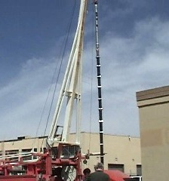
Increased Production │ Reduced Well Cost │ Target Depth Assurance │ Wellbore Integrity
Full Diameter Maintenance Field Demonstrations
Thru-tubing RIH Diameter Isolation Set In Upper Section, 4-1/2” Casing.
Thru-tubing RIH Diameter Sand Reline Set In Lower Section, 4-1/2” Casing.

Slide 11
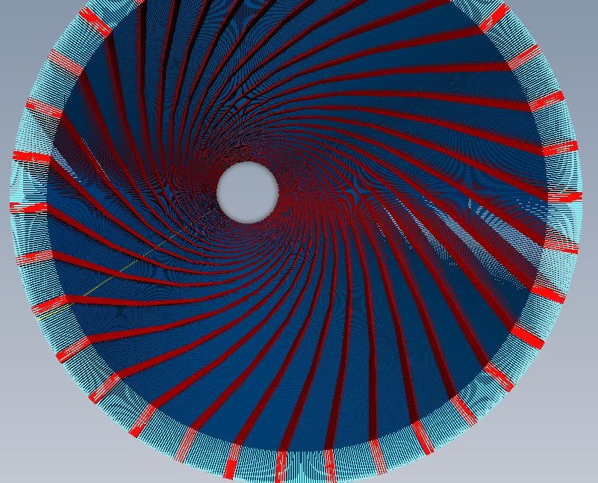
Increased Production │ Reduced Well Cost │ Target Depth Assurance │ Wellbore Integrity
“DTSS” Thru-tubing Relining Screens for Failed Sandcontrol
Self-lines fully against existing screen or
casing, maximizing producible OD and ID.
5X – 10X more plug resistant than any sand
device & can be thoroughly jetted.
Manufactured from high strength, erosion resistant materials, to ceramic levels.
Unlimited system permeability is conducive
to high rate well production.

Slide 12
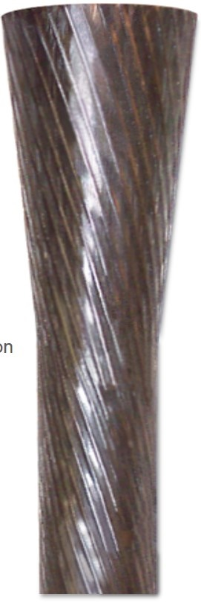
Increased Production │ Reduced Well Cost │ Target Depth Assurance │ Wellbore Integrity
DTS Lattice Sandscreen ― Oversized Diameters Built From High Strength Spring Elements
Oversized Diameter, As Manufactured
5. Excess Spring Energy Supports Wellbore
4. Intended Operating Diameter
3. Recovering Biased-Oversizing
2. Internal Pressure Applied,
Temporary Constraints Released.
1. Temporary, Elastically Reduced
RIH Diameter. Secured.

Slide 13
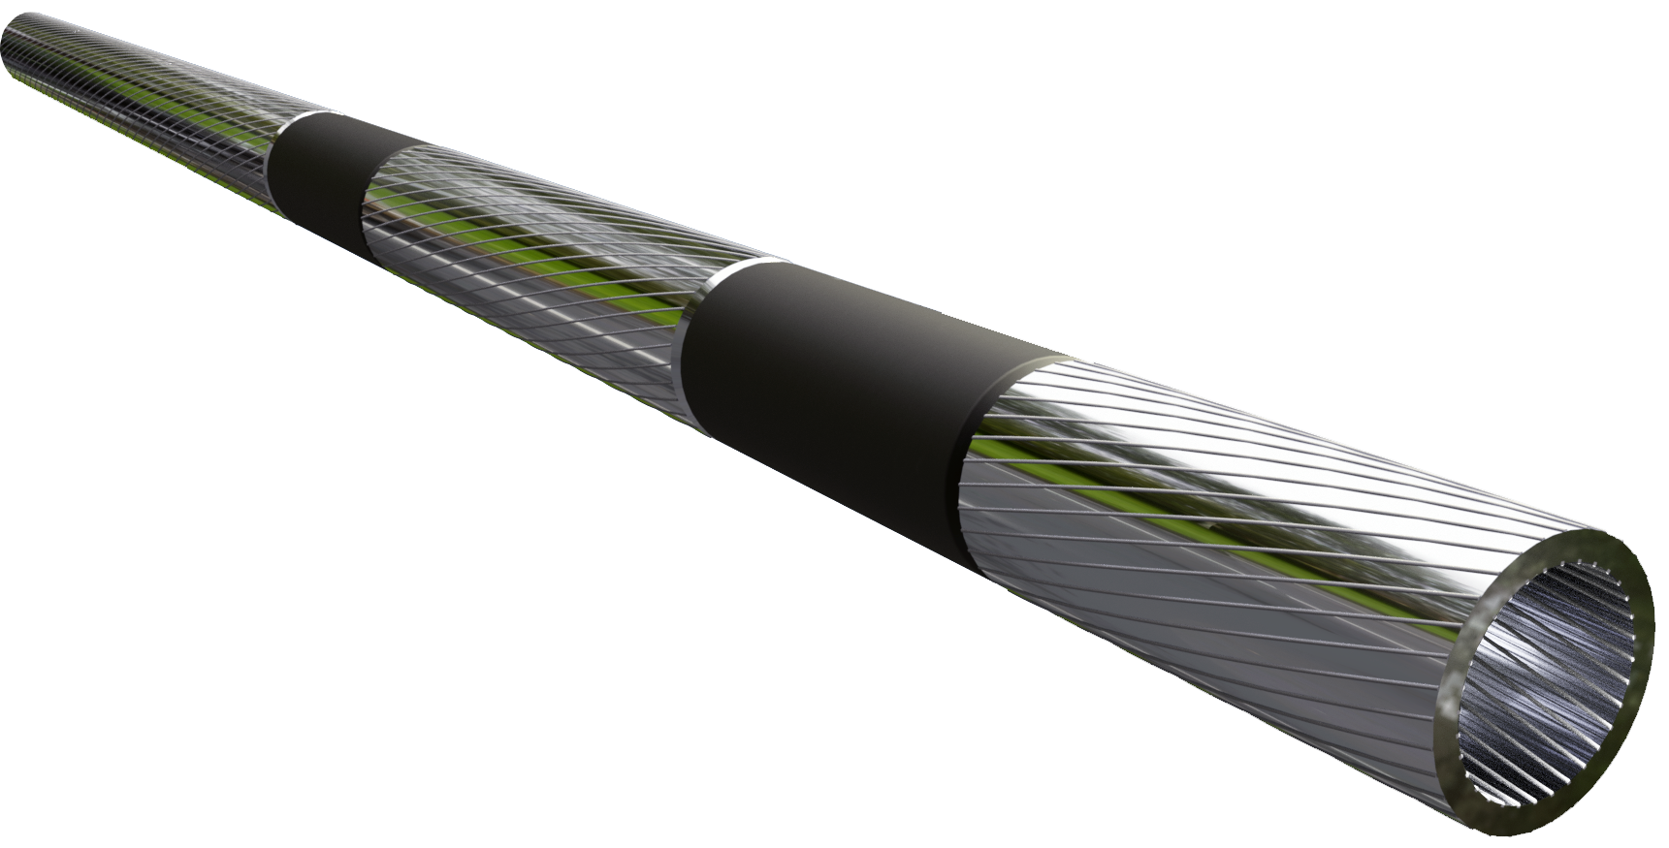
Increased Production │ Reduced Well Cost │ Target Depth Assurance │ Wellbore Integrity
Uses of Large Bore Thru-tubing Sand Relining
Sandcontrol reline remediating normal wear, GP unnecessary
Reline high erosion / compromised frac pack hotspots, no GP
Plug prone environments requiring jetting efficacy
Diameter constrained interventions / recompletions
Low pressure isolation sleeves
Slidable or retrievable hybrid
sleeves & screens.

Slide 14
2.5X Expansion, Elastically Compressed and Recovered 2:1 Opening:Strainer Arrangement.

Slide 15
Increased Production │ Reduced Well Cost │ Target Depth Assurance │ Wellbore Integrity
Initial Standard Well Construction Test Results, Ideal Expanded Sandscreen Properties of Shell & BP Exceeded:
Ideals Industry Standard DTS Capability
A. Expansion Ratio 125%–150% Originally ~116% >170%
B. Ultimate Collapse Rating >2000-psi Originally 250-psi >8,000-psi
C. Flexible Formation Bias-Support 200-psi Unspecified >1,000-psi
D. Axially Subsiding Compliance 10% Non-existent 6%, >10%
E. Net Inflow, Open Area Maximize <12% 60%
F. Mesh Particle Size Retention 50µ – 250µ >125µ >25µ
G. Flow-Area % At Pre-expansion
Min. Intervention Diameter: Maximize Non-existent 20%
Notes:
Describe the technology, secret sauce or magic behind your product. The less text and the more diagrams, schematics and flowcharts, the better. If you have a prototype or demo, this is the time to transition to it. As Glen Shires of Google said: “If a problem is worth 1000 words, a prototype is worth 10 000 slides.”

