Slide 2
Increased Production │ Reduced Well Cost │ Target Depth Assurance │ Wellbore Integrity
DTS Geothermal: Massive Technology and Baseload Clean Energy Growth Opportunities
PROBLEM
Geothermal is Both the Most Economic and the Most Underinvested
Renewable Energy Source:
─ EIA 2022 Projected $/MWh: Geothermal 44.0, Wind 55.8, Solar PV 73.7
─ Upfront costs, development time, subsurface risks deter
─ Baseload hydrothermal + EGS potential = 20%+ global electricity
“All The Above” Energy Strategy Necessary for Carbon Transition

Slide 3
Increased Production │ Reduced Well Cost │ Target Depth Assurance │ Wellbore Integrity
FUNDAMENTAL SOLUTION, PART-A
DTS’s Step Change Well Technology to Initiate Critical Growth
─ Drilling & wells contain the highest development costs and risks, 40% - 55%+ of total
─ Specifically, costs to repair geologic voids are the cause the industry’s small scale
DTS Tubular Technology
─ Instantly “self-lines” wellbore, isolates geologic issues within hours, not days+
─ Avoids 50% of hard rock drilling, eliminates 50% of traditional casings and cement
─ Eliminates 90% of subsurface & investment risk by guarantee of producible diameter
Results
─ Cuts the first 20% to 25% of total development cost
─ DTS Tech renders geothermal the most economic renewable by a factor of 40%

Slide 4
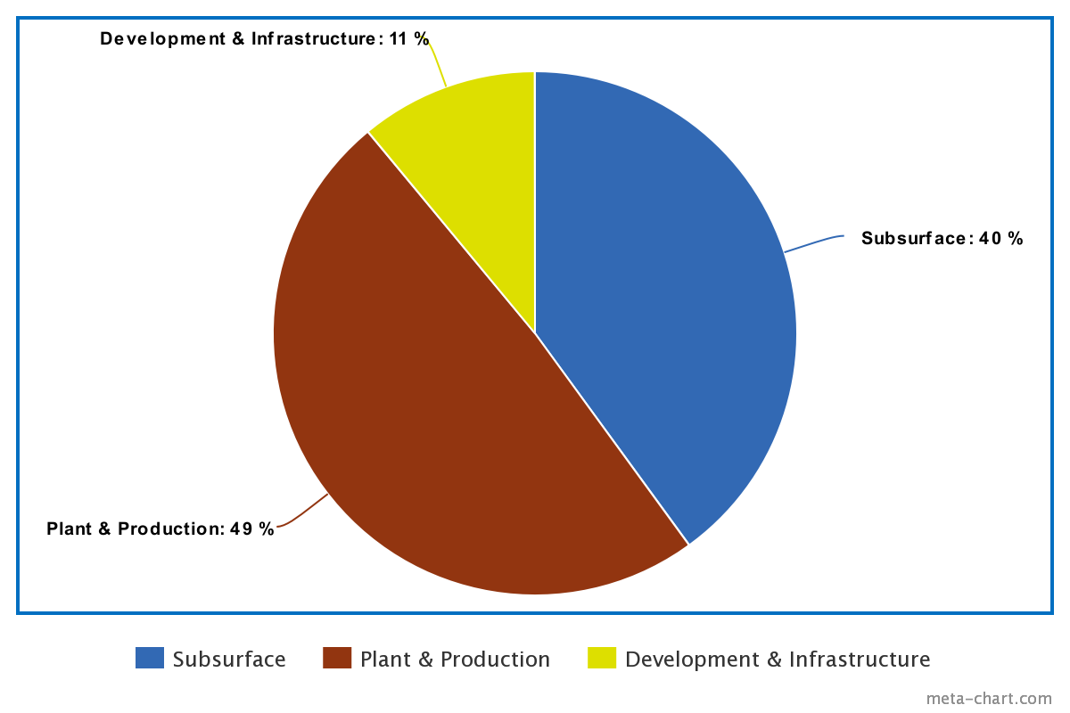
Increased Production │ Reduced Well Cost │ Target Depth Assurance │ Wellbore Integrity
FUNDAMENTAL SOLUTION, PART-B
Integrated Development Services and Materials Group
─ Acquires controlling interests & aligns principal supply chain
─ Cuts the balance of development cost to 1/2 overall, enabling 25X+ growth
DTS Tech Minimizes Extractive Cost, Integrated Operations & Supply Minimize Development & Plant:
DTS Well Technology & Drilling -23%
Dev., Plant, Const., Special Steel - 25%
Total - 48%
Part A + Part B Cost Cuts Render Geothermal the Most Economic Renewable Energy Source by a Factor of 60%.
Traditional Development Costs

Slide 5
Increased Production │ Reduced Well Cost │ Target Depth Assurance │ Wellbore Integrity
Why Invest:
Part A + Part B = 50% Development Cost Cuts,
Surpasses Threshold Enabling 25X – 50X Growth
Creates a $225B Annual HydroThermal Baseload Electricity Business
─ EGS potentially doubles or more HT revenues
─ $15B drilling and well services revenues
50 Year Annualized Return of 14%
─ 19+% total return with partial redevelopment funding
Exclusive Technological Advantage
─ Magnitude of savings
─ 90% de-risking

Slide 6
Increased Production │ Reduced Well Cost │ Target Depth Assurance │ Wellbore Integrity
SOLUTION-A EXPLAINED
DTS Technology: Elastically Self-Lining, High Expansion Ratio Tubulars Set Against Wellbore Geology or Casing
Diametric expansion >300%
Full length outer self-seal instantly
isolates downhole problems.
High strength, pressure, and
thermal compliance.
Can cut geothermal well cost by >50% & eliminate re-drills

Slide 7
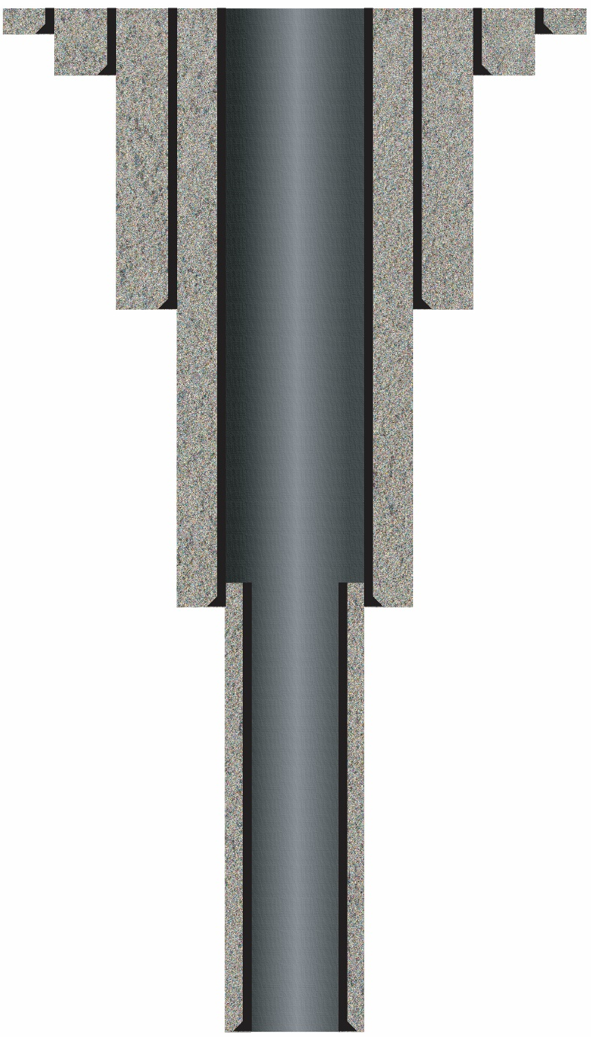
DTS Minimized Well
3,858 Cubic Feet Drilled
Traditional Telescopic Construction
16,865 Cubic Feet Drilled
│
│
48”
8.5”
High Strength Rock
DTS Expanded Tubular
>50% COST, RISK & TIME ADVANTAGES
Cement
Steel Casing
Repeatable, Instant, Discrete Problem-Repairs
53% of Well Investment Produces Energy
12% of Well Investment Produces Energy
5900’ Depth
│
│
8.5”
│
│
8.5”
6

Slide 8
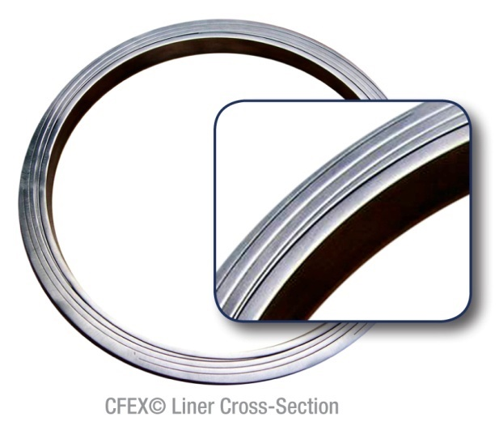
Increased Production │ Reduced Well Cost │ Target Depth Assurance │ Wellbore Integrity
How It Works
Form Oversized Split Tubes from High
Strength Plate.
– Strength enables diameter expansion >300%
Assemble & Join Members as a
Diametrically Oversized Spring-Tubular:
– Laminated assembly
Temporarily Reduce Diameter & Secure
Lower Into Well, Release Elastically Biased
Assembly to its Operating Diameter.
Seal Wellbore by Residual Outward Spring-Energy
– Self-suspending and self-sealing
Notes:
Exaggerated cross-sectional view of leaf-spring structure.

Slide 9
Increased Production │ Reduced Well Cost │ Target Depth Assurance │ Wellbore Integrity
Advantage: DTS Well Technology 50% Lower Cost Than The “Competition”
 | DTS Technology | Traditional Drilling
5900’ Well Cost | $ 2,251,440 | $ 4,690,500
Steel Casing | 1,500’ | 8,000’
Other Materials | 267,322 Lbs. | 1,395,354 Lbs.
Drilling Rig Days | 33 | 59
10 – 12 Wells Required Per 20 MW Installation,
14,000 to 20,000 Estimated Installations to 10% Global Electricity

Slide 10
Increased Production │ Reduced Well Cost │ Target Depth Assurance │ Wellbore Integrity
DTS TECHNOLOGY’S RISK MITIGATION OF GEOTHERMAL DEVELOPMENT
Nearly All Developmental Risk is Subsurface Related, ~50% of Geothermal
Drilling or Wells Fail Objectives:
Presence or quality of resource, geologic voids, instability, mechanical failures
Traditional Solutions → New Solutions:
Traditionally, nothing offered against resource quality → DTS halves exposure,
doubles economic viability.
Unplanned well casings to isolate unceasing geologic issues exceed budget, restrict
productivity → DTS single diameter well capabilities guarantee producible diameter.
Geologic stress failures require redrill → DTS eliminates >90% of problem sources
Later casing failures = lost production & infrastructure, require additional investments:
→ DTS wellbore strengthening perfects conditions for long-term integrity
→ DTS remediation restores full production diameter

Slide 11
Increased Production │ Reduced Well Cost │ Target Depth Assurance │ Wellbore Integrity
Market Pre-Acceptance of DTS Technology
Multi-product customer traction prior to availability
No economic drilling or well solutions available to producers
2.5% annual loss of multi-million dollar wells, “unfixable” damage
Elimination of catastrophic geology stabilization incidences
Customers & investors: producers, developers, sovereign wealth
funds, reconstruction & redevelopment agencies in 40+ countries.

Slide 12
Increased Production │ Reduced Well Cost │ Target Depth Assurance │ Wellbore Integrity
SOLUTION-B EXPLAINED
Supply Chain Acquisition & Integration
Integrated supply chain minimizes other major costs, assures availability
Power plant, drilling, steel account for 80% of developmental investment
Commodity materials and services pricing are cyclical, volatile
Supply chain shortages & inflation are detrimental, often blocking development
Supply chain acquisition
Five-year market caps may vary 2400%
Controlling interest investments are self-sustaining through normal business
Geothermal business adds revenue, stability, spreads costs, deploys spare capacity
Results
─ Cuts another 25% of total development cost
─ Integrated supply chain + DTS Tech renders geothermal the most economic
renewable by a factor of 60%.

Slide 13
Increased Production │ Reduced Well Cost │ Target Depth Assurance │ Wellbore Integrity
DTS Group Advantage
Example Standard $60M 20MW Development: 45% Savings
 | Traditional Development Cost, $M | DTS Tech & Group’s Costs
Administrative | 4.1 | 3.0
Exploration & Confirmation Drilling | 2.8 | 1.2
Production & Injection Wells | 19.0 | 7.6
Wellfield Production System | 5.8 | 4.4
Power Plant | 23.0 | 18.4
Connection & Infrastructure | 5.3 | 4.2
Specialty Steel | -- | (6.3)
Totals | $ 60,000,000 | $ 32,920,000
Cost Per MW | $ 3,000,000 | $ 1,635,000
Percent Savings | -- | 45%
Schedule Compression – Subsurface | -- | 6 Months
14,000 - 20,000 Installations to 10% Global Electricity

Slide 14
Increased Production │ Reduced Well Cost │ Target Depth Assurance │ Wellbore Integrity
DTS Tech vs. Group Revenue Summaries ($M)
Series A: DTS Tech, 4.2% Current Hydrothermal Market Growth Rate
Drilling & Exploration Products $ 135
Remedial Products $ 60
Series B: DTS Technology + Drilling Services Integral
New Well & Exploration Drilling $ 471
Well Remediation $ 225
Series C: Integrated Supply Chain Peak Rev. During 25 Year Growth
Developers, at cost $ 840
All Drilling, at cost $ 7020
DTS Products $ 5265
Power Plants, at cost $ 16,800
Specialty Steels & Metals, at cost $ 12,980
E&C, at cost $ 8653
Electricity Generation (HT only) $ 225,000

Slide 15
Increased Production │ Reduced Well Cost │ Target Depth Assurance │ Wellbore Integrity
DTS Tech $29.5M Series A Deliverables
Completed | Series A | Future
Broad concept elucidated 50 Apps identified Two subsurface demos Twin testing programs | Manufacture commercial lengths and quantities. | Deploy pertinent of 50 applications portfolio.
Products
Introduction and preliminary commitments gained for two applications. | BD and sales in Americas Commercial trials Commence international BD | Full global presence
Market Acceptance
Technical team foundation Manufacturing processes developed. | Extend manufacturing machinery. Build preliminary plant Augment plant | Expand manufacturing Commence drilling services Resource co-development Finance development
Operations

Slide 16
Increased Production │ Reduced Well Cost │ Target Depth Assurance │ Wellbore Integrity
Series A Assumptions
New Well Drilling Segment | Exploratory Drilling Segment | Well Restoration Segment*
New Wells Drilled Annually 250 | New Wells Drilled Annually 270 | 2.5% Annual Failures + Inventory (450) 100
80% Applicability 200 | 80% Applicability 216 | Mean Lost Electricity Revenue $2.9M
Major Liner Repairs, Per Well 3 | Major Liner Repairs, Per Well 2 | Mean Well Replacement Cost $4.5M
Beginning Drilling Liner Installs. 600 | Beginning Drilling Liner Installs. 432 | Infrastructure Replacement Cost $350K
Traditional Repair Cost, Each $330K | -- | Annual Costs, B/S, P&A Liabilities $.5-$6M
DTS Liners Per 50’ Installation $150K | DTS Liners Per 50’ Installation $100K | DTS Liners Per 200’ Installation $600K
Begin./Current New Well Market $90M | Begin./Current Explor. Market $43M | Beginning Liner-Remediation Market $60M
Yearly Segment Net Revenue $45M | Yearly Segment Net Revenue $21.5M | Yearly Segment Net Revenue $35M
*Well retrofit opportunities are not included.

Slide 17
Increased Production │ Reduced Well Cost │ Target Depth Assurance │ Wellbore Integrity
$100M+ Series B Deliverables:
DTS Tech + Drilling Services
Series B
1. Adoption of DTS Tech as standard procedures in the industry. 2. Complete 80% market penetration within six years after commercial status. 3. Acquisition of 50 drilling rig fleet and support systems. 4. International BD presence established in all pertinent regions and countries. 5. 100 damaged well acquisitions & sell-backs annually, as performed by DTS drilling equipment. 6. Electricity revenues through strategic developer and producer partnerships. 7. Integrated services, materials, and redevelopment funding BD group to close acquisitions and funding, commencing Series C.
Business Development
1. DTS Tech manufacturing facilities expanded to 90,000’ annual capacity. 2. Commence custom product development and manufacturing. 3. Establish infrastructure and personnel for 50 rig operation. 4. Establish resource development, steam production, and electricity generation support group.
Operations

Slide 18
Increased Production │ Reduced Well Cost │ Target Depth Assurance │ Wellbore Integrity
Series B Assumptions
New Well Drilling Segment | Exploratory Drilling Segment | Well Restoration Segment
New Wells Drilled Annually 295 | New Wells Drilled Annually 270 | Mean Well Acquisition Cost $158K
80% Applicability 236 | 80% Applicability 216 | DTS Rig Internal Monthly Cost $500K
Major Liner Repairs, Per Well 3 | Major Liner Repairs, Per Well 2 | DTS Liner Assembly Internal Cost $200K
5-Year Proj. Drilling Liner Installs. 708 | 5-Year Proj. Drilling Liner Installs. 509 | External Services & Tool Cost $200K
DTS Liner Revenue @ $150k Ea. $106.2M | DTS Liner Revenue @ $100k Each $51M | Total DTS Restoration Cost $1.06M
One Month DTS Rig Revenue $1M | One Month DTS Rig Revenue $600K | Mean Restored Well Value $2.25M
Required Rig Acquisitions 25 | Required Rig Acquisitions 19 | Per Well Profit $1.19M
Rigs Yearly Gross Revenue $236M | Yearly Gross Revenue, Rigs $77.5M | Restorations Per Rig-Year 11
-- | -- | Required Rig Acquisitions 15
Yearly Combined Revenue $342M | Yearly Combined Revenue $128.5M | Yearly Segment Gross Revenue $225M
Yearly Segment Net Revenue $171M | Yearly Segment Net Revenue $64M | Yearly Segment Net Revenue $119M
1. Estimates are five years after Series A commercial deployment and based on 4.2% current growth rate.
Acquisition of drilling assets are opportunistic due to highly cyclical O&G industry. Complete used rigs are assumed $10M each, plus 10% investment in support systems.
DTS Tech manufacturing expansion is internally funded.
Electricity revenues are not included.

Slide 19
Increased Production │ Reduced Well Cost │ Target Depth Assurance │ Wellbore Integrity
Series C High Growth = DTS Tech + Integrated Supply Group
Description: High growth stage, 25X to 28X over the current 0.35% production electricity level. Duration is 25 years. Integrates substantial capacities in drilling, power plant, developer, construction, steel, and manufacturing areas through majority share acquisitions. Assumptions include hydrothermal resources only, EGS doubles amounts.
Acquisitions: Steel and drilling industries are highly cyclical, have extensive spare capacity, and are sustainable standalone investments. Five year market caps may vary 1600%. Long-term geothermal development adds revenues and markets, deploys spare capacity, and mitigates business instability, in exchange for modest pricing of surplus resources.
Drilling resources needed: 1000 rigs for 25 years.
Specialized steels: 8M tons annually, 25 years.
Geothermal developers, plants, and related do not have extensive capacities and require organic growth.
Expected investment in supply chain acquisitions in 2019 dollars: $12B

Slide 20
Increased Production │ Reduced Well Cost │ Target Depth Assurance │ Wellbore Integrity
Series C, Finance of 10% Clean Baseload Energy
10% Total Global Electricity 2750 TWh
Mean Hydrothermal Site Output 20 - 23 MWh
Estimated Required New Sites 14,000 - 20,000
Quantity of Exploratory, Production, and Injection Wells 270,000
Mid-Low Traditional Developmental Investment, $/MWh $3,000,000
Overall Nominal Investment, Traditional Practices $840B - $1.05T
Revised Developmental Investment: DTS Tech + Group, $/MWh $1,635,000
DTS-Revised Nominal Investment $457B - $575B
Required Investment, Self-Generation / Free Cash Flow Basis $157.2B
Annualized Return with 20% Redevelopment Funds, 50 Years 19.44%

Slide 21
DTS Technology Team Strengths
Proved technology and manufacturing considered impossible by major oil
$1B development cost quote by R&D institute, team performed for $5.5M
Well balanced business, energy industry, and technical expertise
Successes include:
Advanced, broad product concept and design
Conversion of high strength materials
Novel manufacturing process developments
Novel manufacturing machine design-builds
Two different product deployments within 30 months from start

Slide 22
Advisory and Technical Team
CEO, J. Spray: 30 years BD, technology, and novel manufacturing process development in drilling, supply, services, and equipment for oil, gas, water, geothermal, and environmental industries. Has founded and run four drilling and technology development companies.
Operations Mgr., D. Capostagno: 20 years experience in mechanical, electrical, materials, machine controls, automation, laser, and manufacturing design engineering, R&D, and technology. PMP, Six Sigma, M.S. Technology, MBA, International Business and Finance.
Engineering Director, R. Ramirez: 20 years mechanical design and engineering, Class-1 precision machining, CNC programming, manufacturing, novel manufacturing process, machine, product, and technology development. Recipient of Journal of Petroleum Technology-OTC Spotlight On New Technology and Hart Energy Special Meritorious Engineering and Innovation Awards, 2017.
Advisor, L. E. Capuano, Jr. – Forty years drilling engineering, well design, and consulting. He founded and led for 30 years ThermaSource, LLC, a geothermal consultancy and drilling contractor providing cementing and additional supporting technical and management services, resource assessment and development advisory throughout the Americas and the Pacific Rim. Long term board member for GRC and the International Geothermal Association; former board GEA; founding president, Geysers Geothermal Association.
Advisor, W. K. Ott: 35 years in drilling, completions, stimulation, HF, cementing, formation damage control, sandcontrol, education and training. SPE Distinguished Lecturer. Geothermal experience covers Japan, Indonesia, and Philippines. Authored over 20 handbooks and articles. B.S. ChemE, Registered P.E., Texas.
Advisor, D. Schwemmer Jr.: 35 years metallurgy, technology, welding, and engineering background. M.S. Metallurgical Engineering, MBA UD. Colorado School of Mines Distinguished Achievement Medalist.
Advisor, P. Smith: Over 30 years operations management and product development in D&C with major oil service companies in North Sea, Europe, West and North Africa, Middle East, and US markets. Global SME and author of 20 SPE papers concerning well construction, liner systems, liner hangers, swellable elastomers, and openhole completions.
Advisor, N. Mendez: 20 years reservoir engineering, production, interventions, planning, acquisitions & divestitures for major oil in W, Africa, Venezuela, Sakhalin, UAE, and US GOM and Pacific shelf. Specialist in completions, production optimization, artificial lift, sand control, and extended reach wells. M.S., Energy and Mineral Economics.
Ancillary advisory includes CFA Toronto, past President; Houston Technology Center Advisory

Slide 23
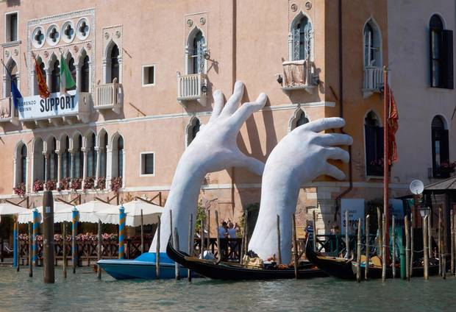
Dire Needs for All-The-Above Clean Energy Action
C.

Slide 24
Increased Production │ Reduced Well Cost │ Target Depth Assurance │ Wellbore Integrity
APPENDIX

Slide 25
300% Expansion Drilling Liner
http://dynamictubulars.com/high_speed_lab_film.htm

Slide 26
Increased Production │ Reduced Well Cost │ Target Depth Assurance │ Wellbore Integrity
Series A Mitigated Risks
Risk | Mitigation
Cost Control
Steel price inflation | Coincides with high energy prices and development levels.
 | Laminated structure allows less costly materials’ substitution.
 | Primary products have 5X+ margins, tolerate variances.
Market & Regulatory Acceptance
Limits product’ use | Already demonstrated through two early commitments for new drilling, and for remediation.
 | Products only augment current technology performance.
Political Risk
International obstacles | Future subject. International development agencies de-legitimize impediments.
IP Advantage
Infringement | Protection of practical embodiments. Proprietary and difficult manufacturing.

Slide 27
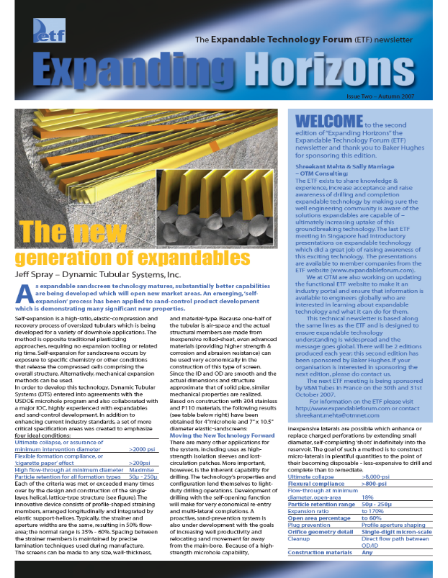
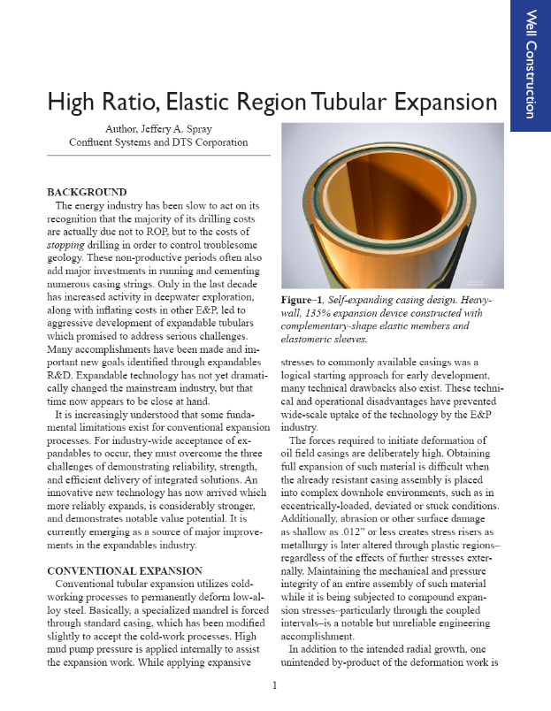
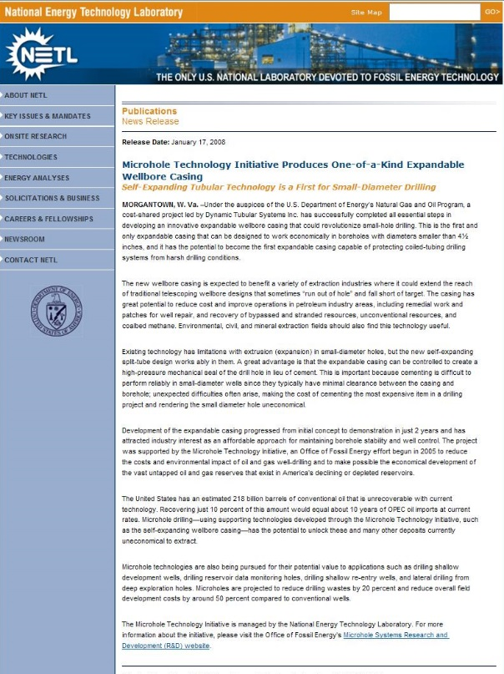
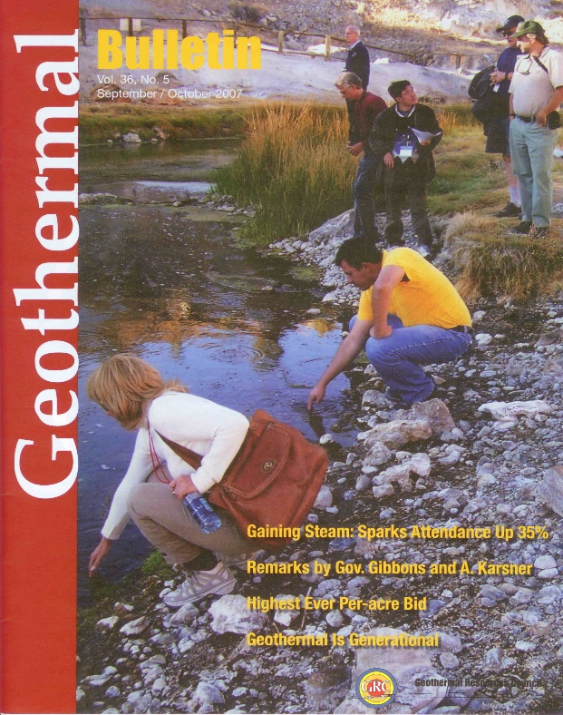
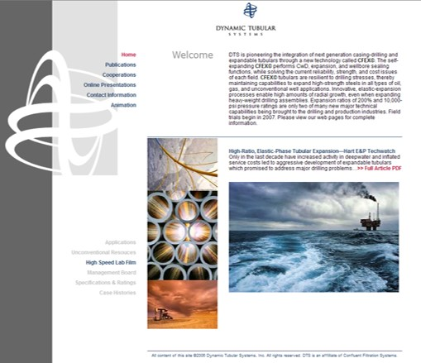
Patented © 2018, 2019 Dynamic Tubular Systems, LLC

